Slide 1


Slide 2



Social Network Analysis
Twitter and our motivation

Slide 3
Problem Definition
Analysis of the flow of information with restrictive small statements
Study connections that occur in complex social network structures
Celebrity Bias Distortion
Network structures could be classified in different segments using density, modularity

Slide 4

Data Source
Tweeter-Dynamic-net (https://www.aminer.org/data-sna#Twitter-Dynamic-Net)
156,487 users
99,696,204 tweets
28,699,842 replies
11,408,918 retweets

Slide 5
Data Format Network Data
First Column | Second Column | Third Column
Person ID 1 | Person ID 2 | Timestamp of follow (P1->P2)
Sample Data
First Column | Second Column | Third Column
0 | 11 | 1

Slide 6

DATA FORMAT TWEET DATA
FORMAT
User Name
Tweet_ID
Time
Via
retweet_from
reply_to_user reply_to_tweet
content
Number_of_link_in_tweet
URL, @user
type_of_link1 link1
type_of_link2 link2
type_of_link3 link3
SAMPLE DATA
Joes_face
8977943263
Thu Feb 11 21:13:40 +0000 2022
via TwitPic
-1
-1
21589626 20760882
3
tweet-url web
http://twitpic.com/12ndbp
tweet-url username/joejonas
tweet-url username /nickjonas

Slide 7
Data And some Details
● All follow relationships of Twitter at year 2018
● Unipartite, directed network
● Unweighted edges
● No multiple edge
● Contains directed cycles
● A snapshot, hence not the whole picture
A
B
A
B
A is following B
But B is not following A
A is following B
and B is following A

Slide 8

Data And some Details
● 1,468,365,182 follow relations (edges) among
● 41,652,230 users (nodes)
● Maximum out degree 5,000
● Maximum in degree 2,997,469

Slide 9

Data And some Details
● Number of triplets 123,435,589,564,841
● Number of triangles 34,824,916,864
● Clustering coefficient 0.000 846 391
Triplet
Triangle

Slide 10
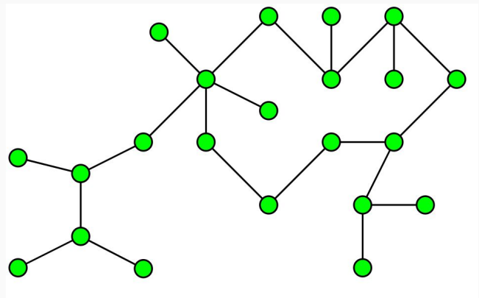

Data And some Details

Slide 11
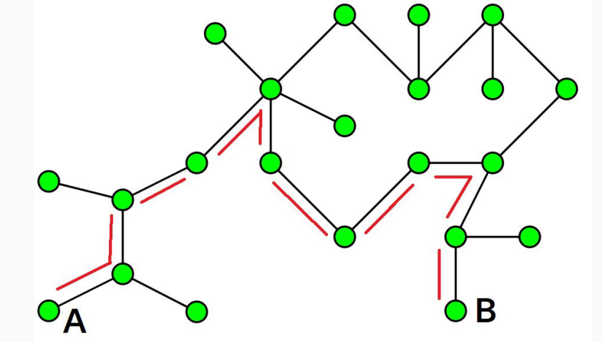
Data And some Details
Diameter is the maximum distance between two vertices of a graph
● Diameter of the graph 23

Slide 12
Proposed Workflow
Applying Graph Theory
● Cumulative Degree Distribution
● Spectral Graph drawing
● HOP distribution
● In/out degree scatter plot
Analysis
Predictive Insight

Slide 13
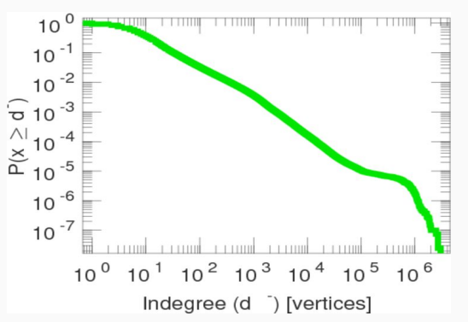
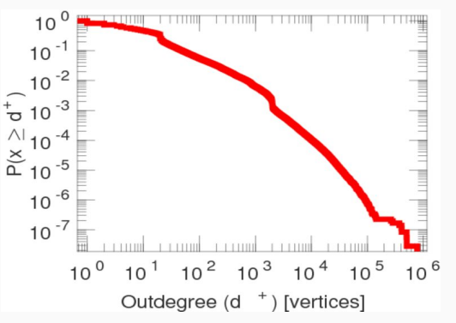
Cumulative Degree Distribution

Slide 14
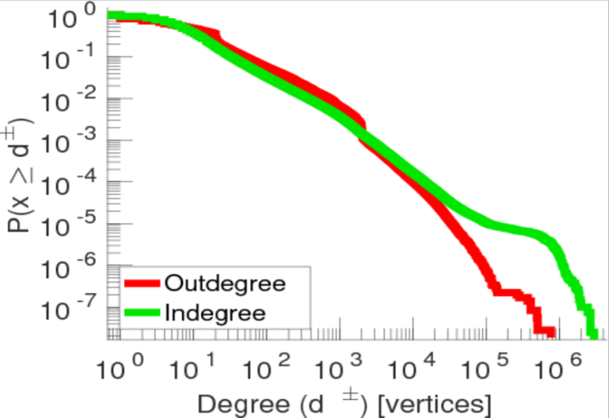
Cumulative Degree Distribution
Figure: In-degree and out-degree nodes plotted simultaneously for comparison

Slide 15
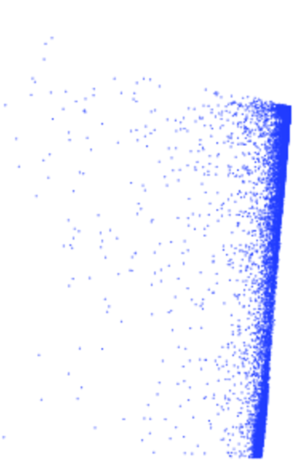
Spectral Graph Drawing
The spectral approach for graph visualization computes the layout of a graph using certain eigenvectors of related matrices
Some important advantages of this approach are an ability to compute optimal layouts in a compact computation time

Slide 16
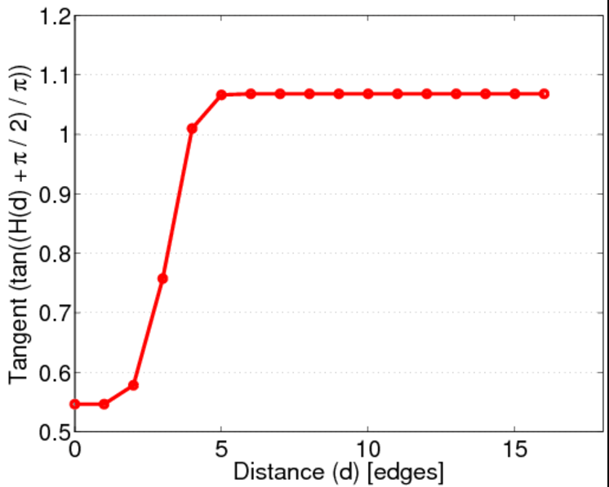
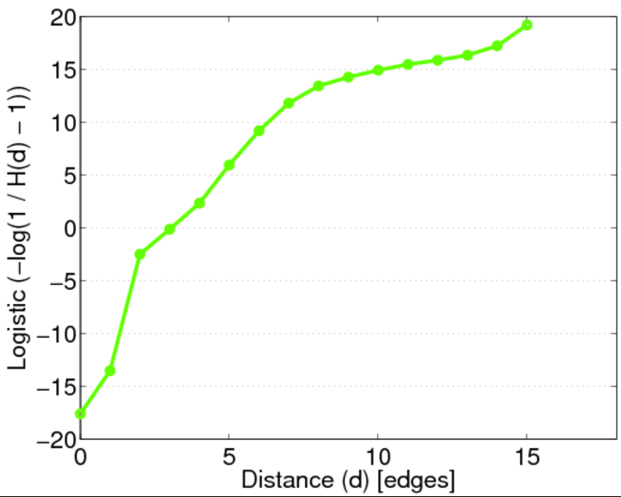
HOP Distribution
HOP distribution is a graphical representation of certain nodes in a network if they can be defined in pairwise distance criteria

Slide 17
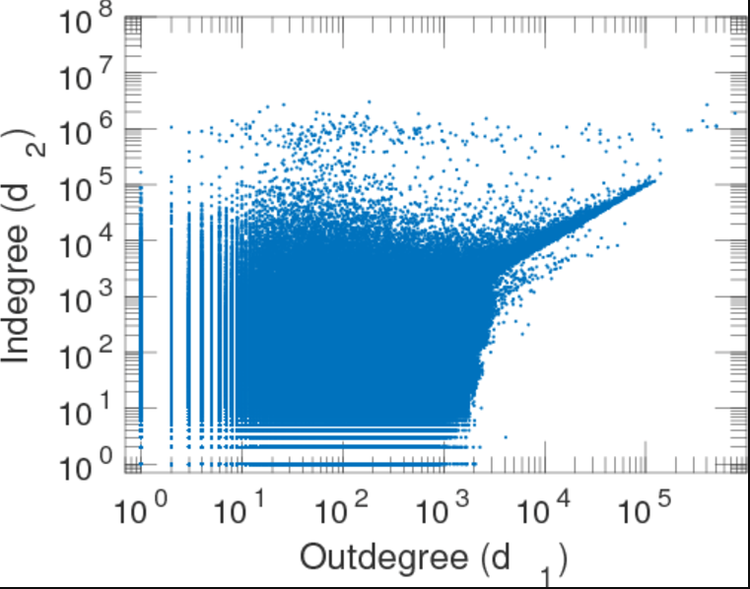
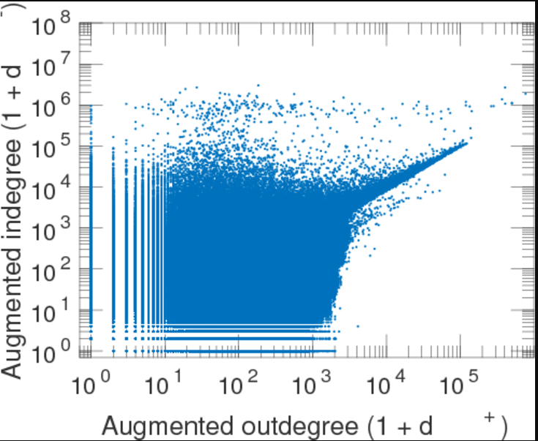
In/Out Degree Scatter Plot
Scatter plot graphs are useful for comparing large numbers of data points without regard to time

Slide 18

Challenges
● Difficulty in monetizing huge dataset
● Issue in collecting data due to lack of access
● Problem regarding the process of plotting metrics

Slide 19

Final Thoughts
Some of the nodes in test dataset showed biasedness, Hence proved our preliminary expectation of celebrity biased distortion
Our analysis showed us possible ways of directing apprehensive nodes
We propose a dynamic framework that will leverage our analysis techniques to predict apprehensive activities

Slide 20

References
THE TWITTER EXPLORER: A FRAMEWORK FOR OBSERVING TWITTER THROUGH INTERACTIVE NETWORKS [https://arxiv.org/ftp/arxiv/papers/2003/2003.03599.pdf]
Social Network Analysis and Mining: Privacy and Security on Twitter [https://www.researchgate.net/profile/Zahraddeen-Gwarzo-2/publication/356172278_Social_Network_Analysis_and_Mining_Privacy_and_Security_on_Twitter/links/618e9584d7d1a f224be0d1d8/Social-Network-Analysis-and-Mining-Privacy-and-Security-on-Twitter.pdf]
What is Twitter, a Social Network or a News Media?[https://citeseerx.ist.psu.edu/viewdoc/download?doi=10.1.1.947.64&rep=rep1&typ e=pdf]
dynamic Analysis of Twitter and Facebook Through Social Network Analysis [https://www.iaras.org/iaras/filedownloads/ijels/2021/002-0001(2021).pdf]

